Slide 1
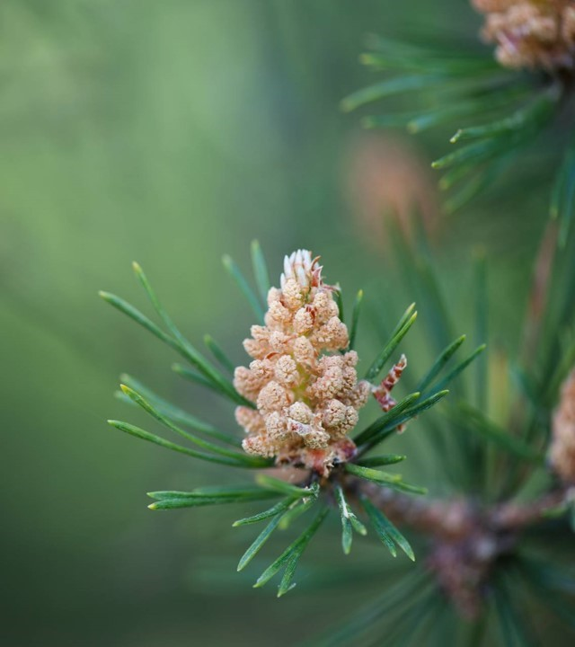
Wildfire risk and weather metrics prediction for Canada Alexandra Landry Capstone project May 2024
Concordia University continuing education

Slide 2
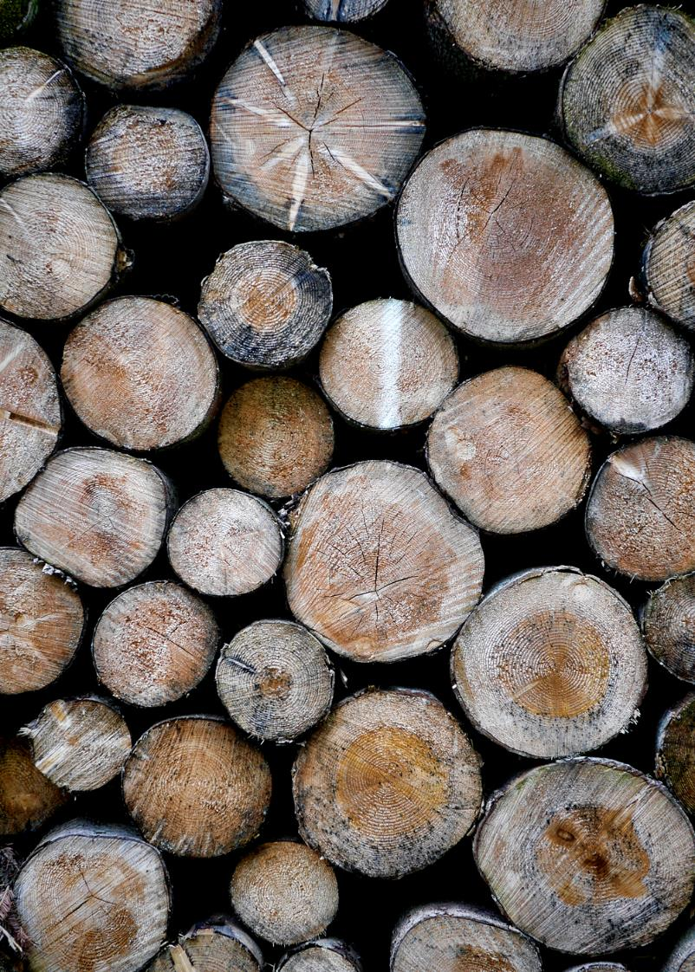
Table of content
Project objective
Data gathering
Project evolution
Feature selection
Predictor selection
Model selection
Models testing
Models training, tuning and validation
Streamlit deployment
Conclusion

Slide 3
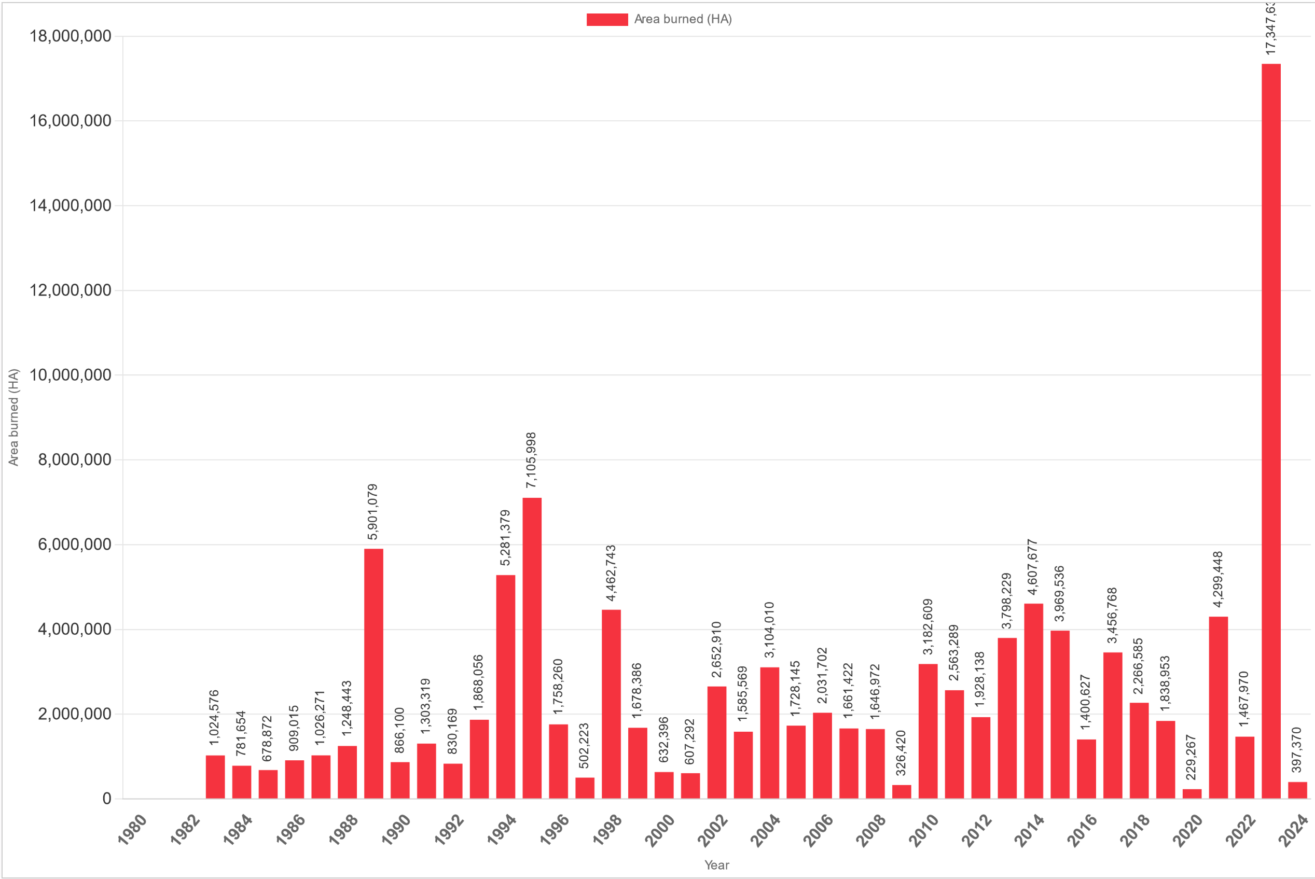
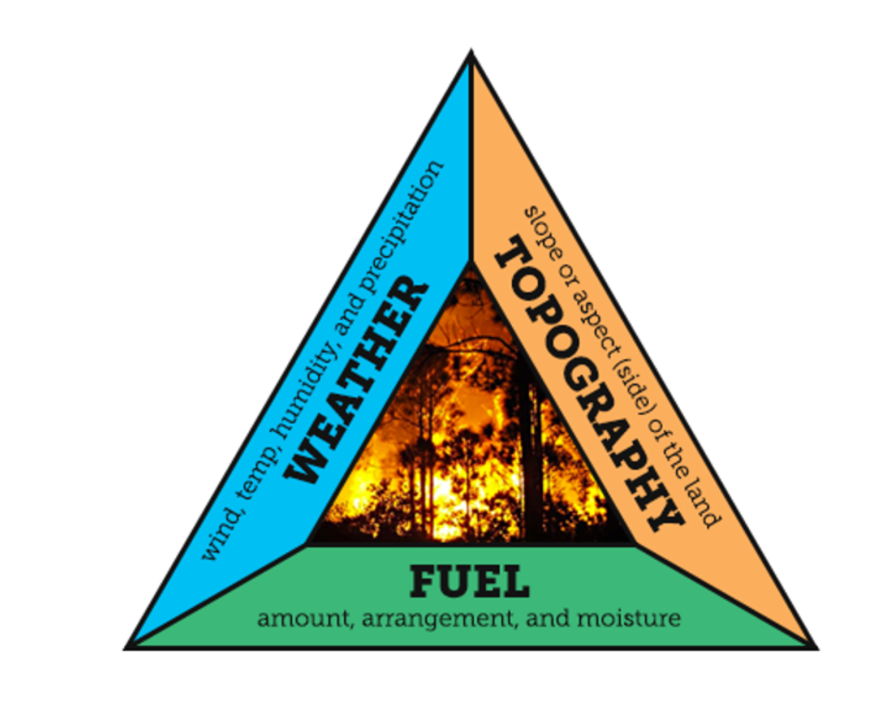
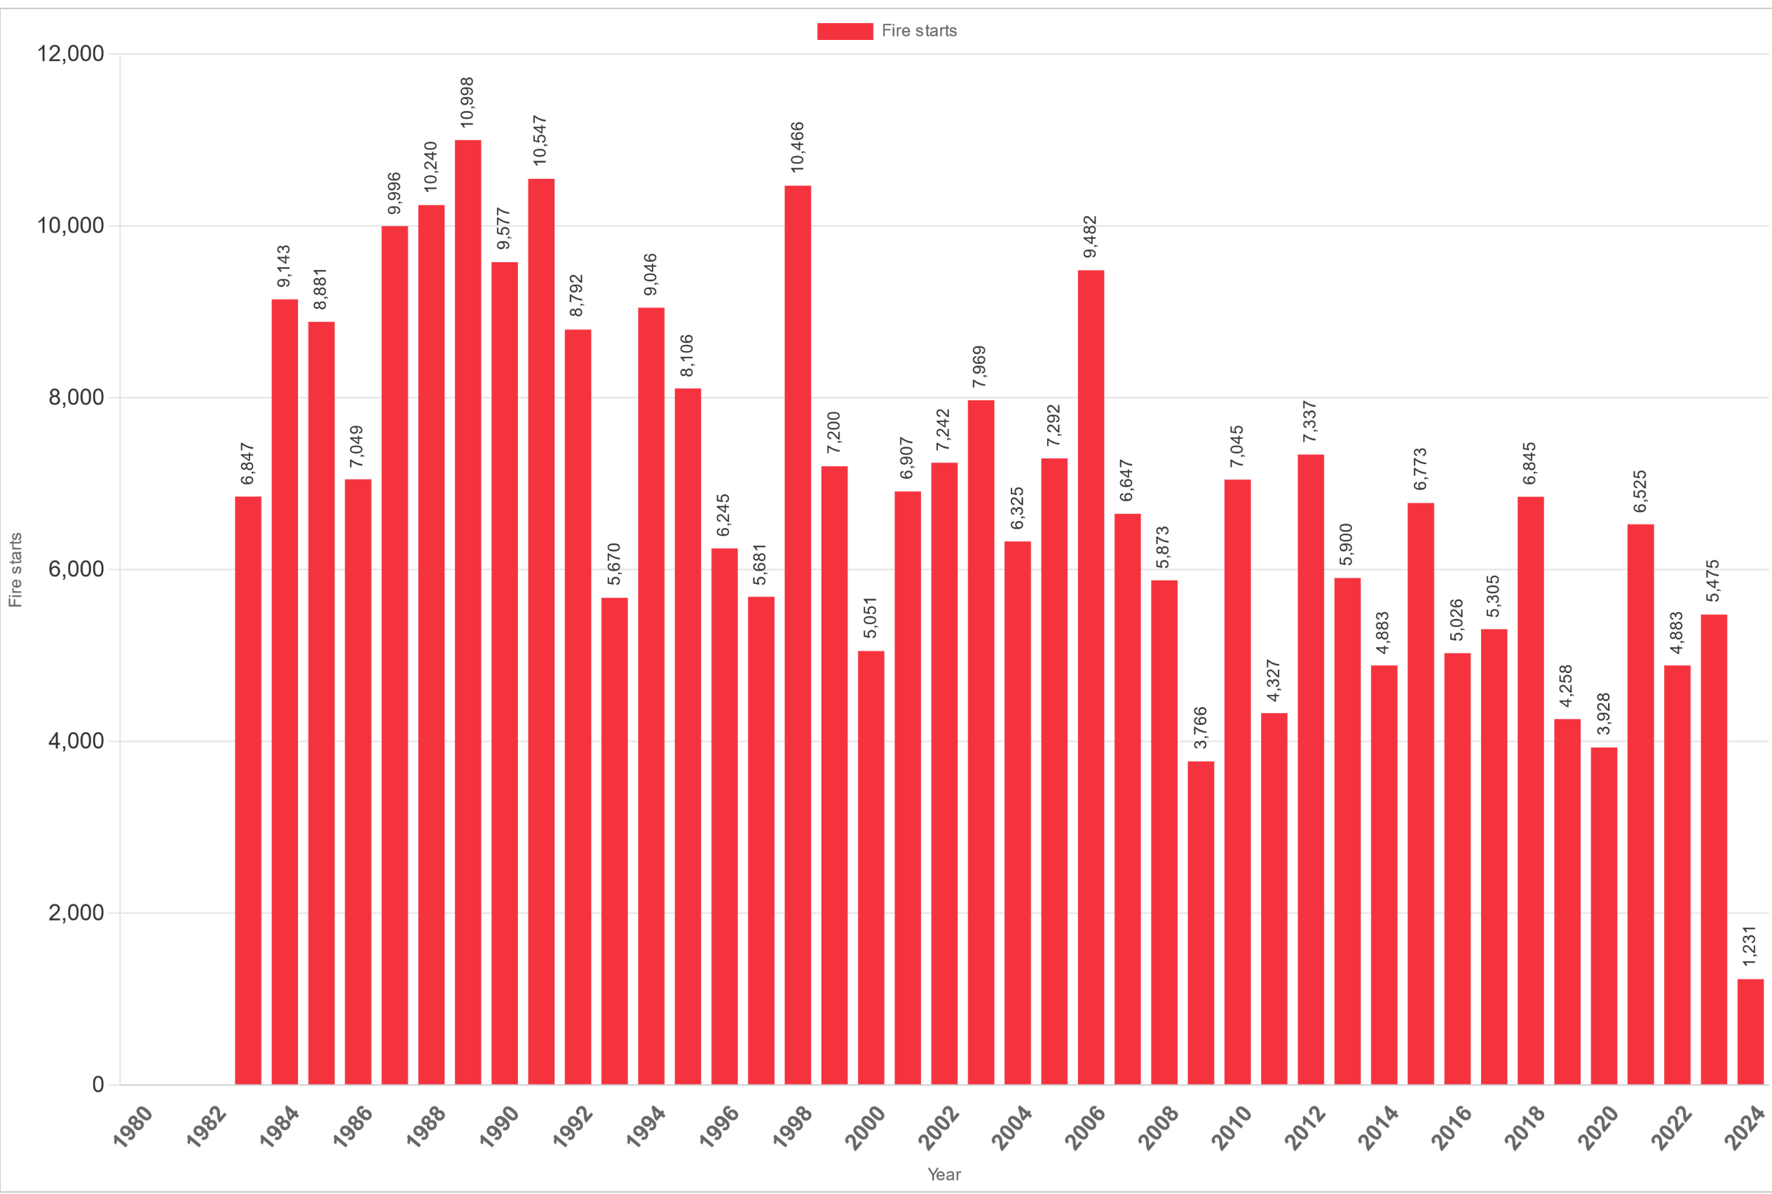
Project objective
Area burned
The first idea behind this project was to predict wildfire risk base on region and on past season weather
Wildfire understanding:
2023 record for area burned
1989 record for fires number
Number of fire
Wildfire in Canada, 2 main causes:
Lightning
Human
(responsible for more than half)
Types of wildfires:
Crown fires
Surface fires
Ground fires
https://www.canadawildfire.org/wildfirefacts
https://ciffc.net/statistics

Slide 4
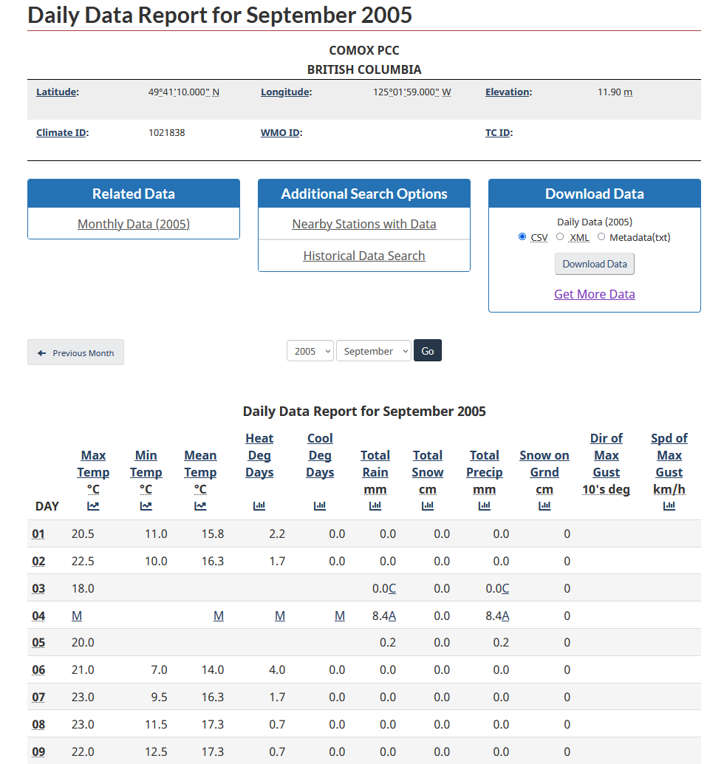
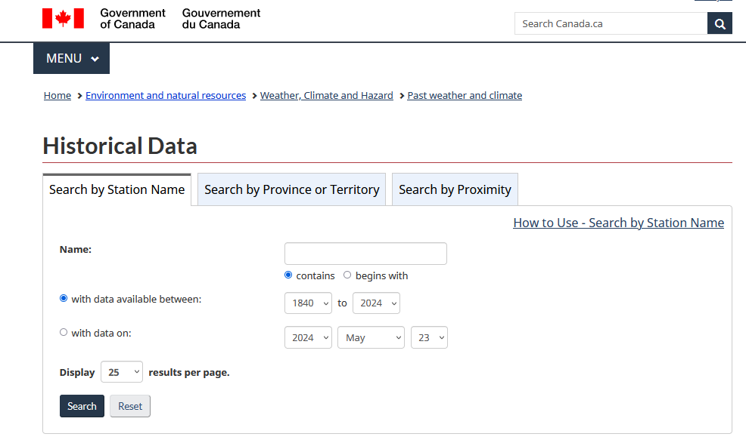
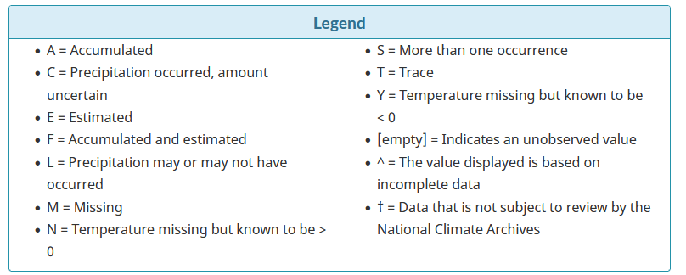
Weather Data
https://climate.weather.gc.ca/historical_data/search_historic_data_e.html

Slide 5
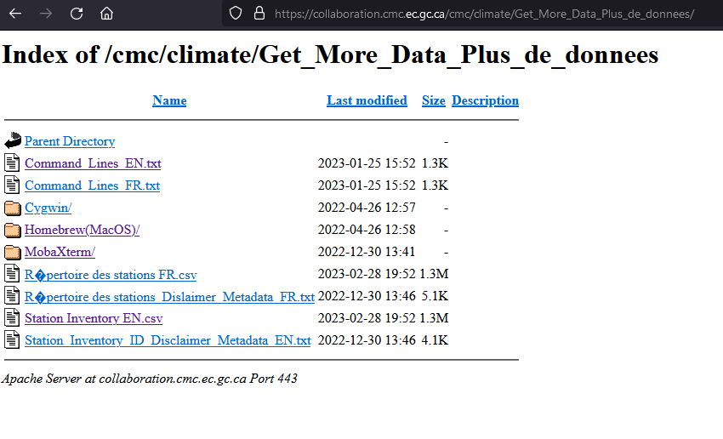
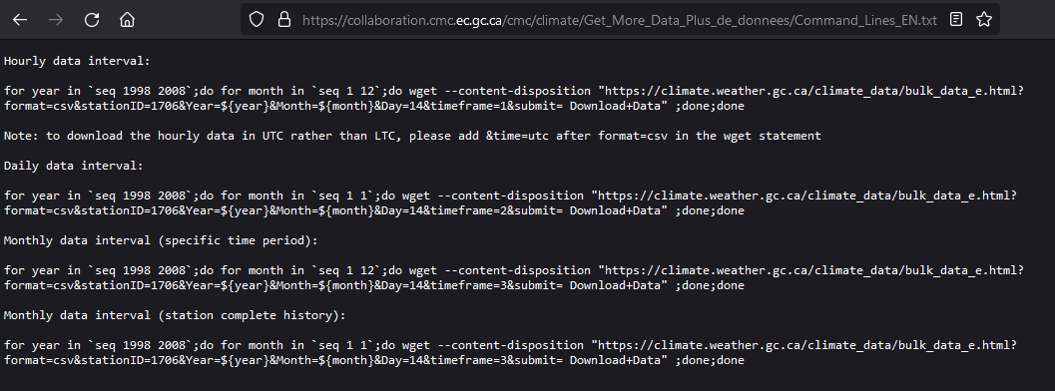
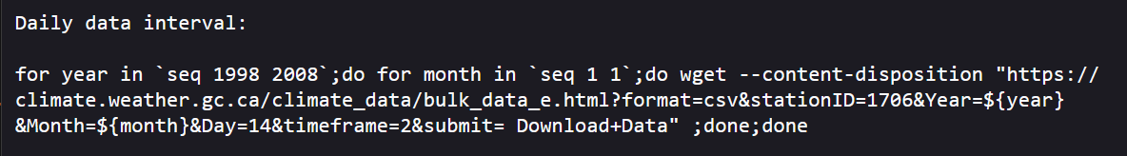
Weather Data
Containing list of all weather station in the historical data from Government of Canada

Slide 6
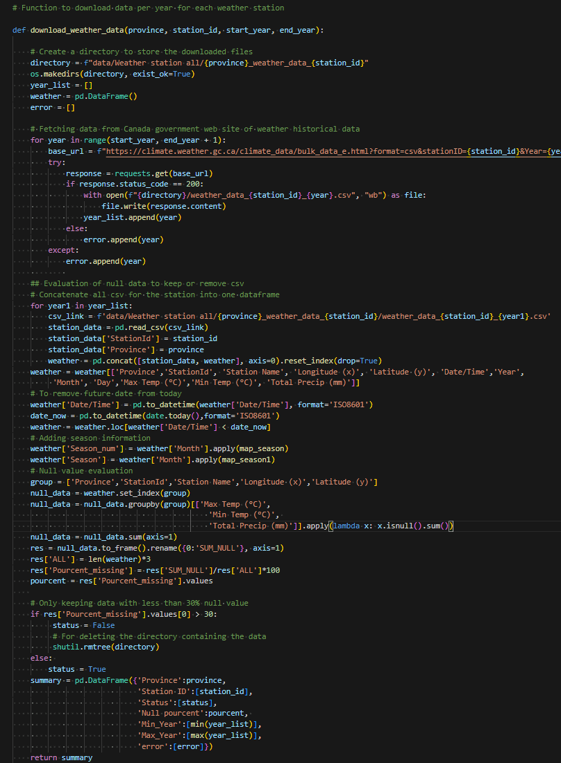
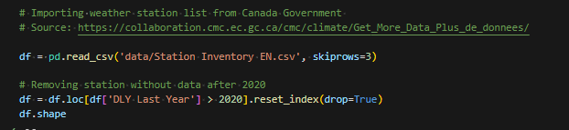
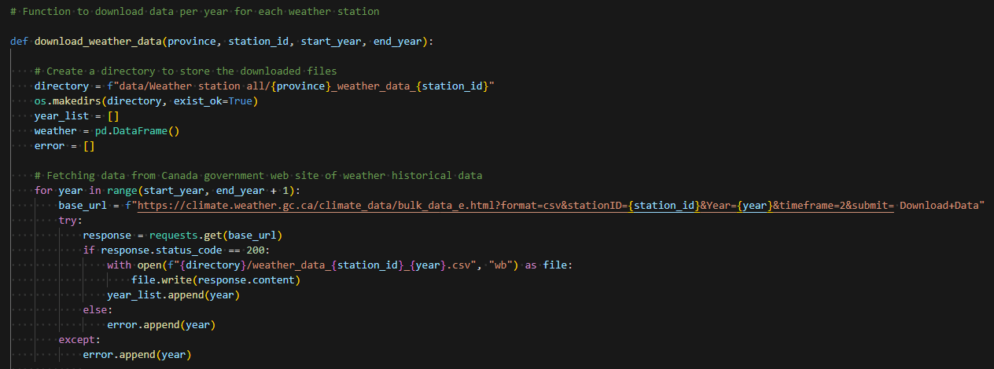
Weather data extraction

Slide 7
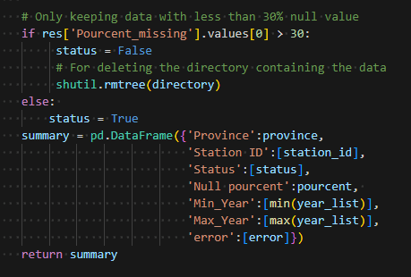
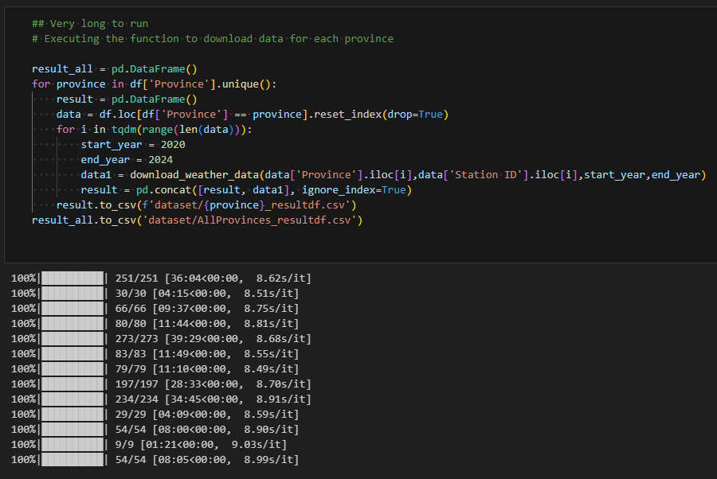
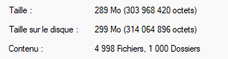
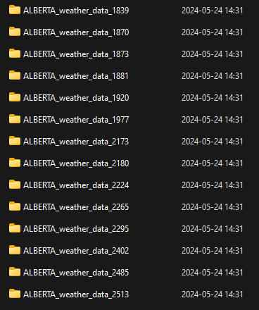
Merge data
From tqdm library

Slide 8
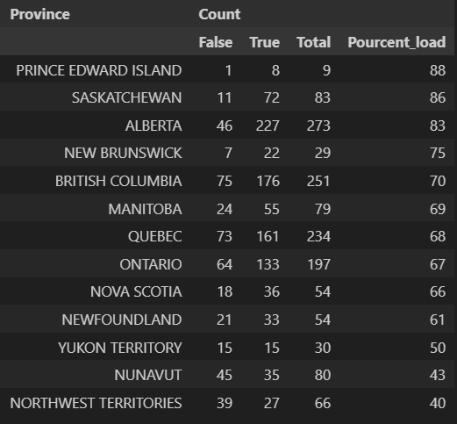
Active weather stations
Analysis of stations with missing values per province and territories in Canada
True: Less than 30% missing values, False: More than 30% missing values
All Canadian Territories have less or egal than 50 % weather station with to much missing data
Manitoba, Ontario and Québec have between 30 % and 40 % weather station with to much missing data. Most of those station are in remote area

Slide 9
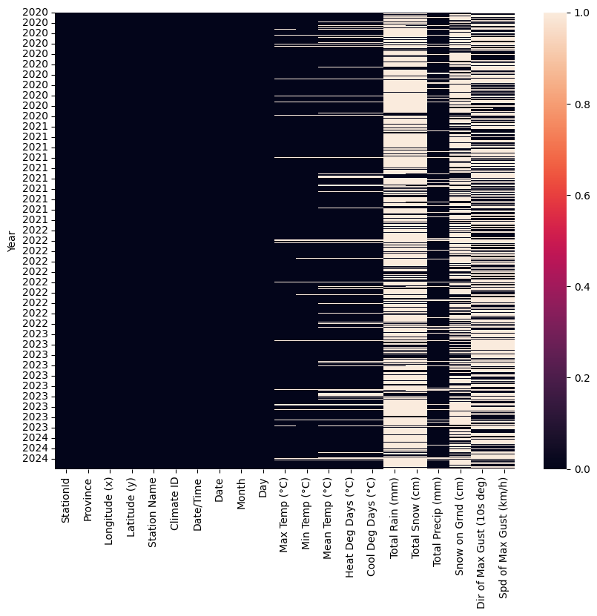
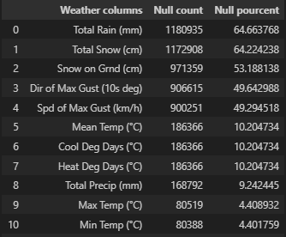
Data quality
Null value in the Government of Canada historical data

Slide 10
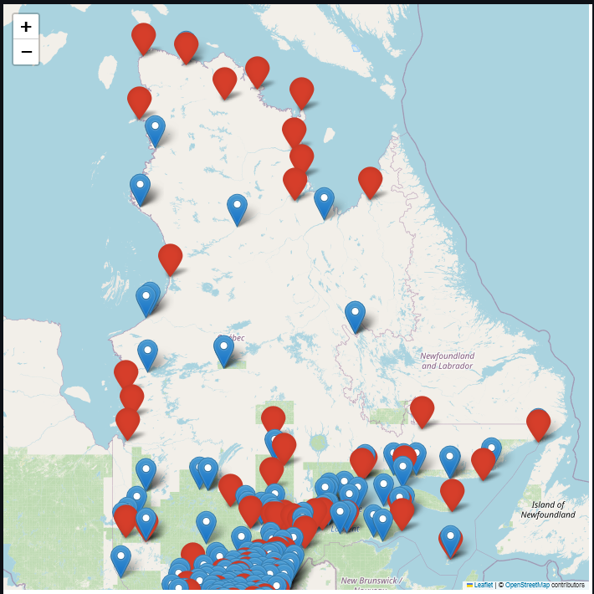
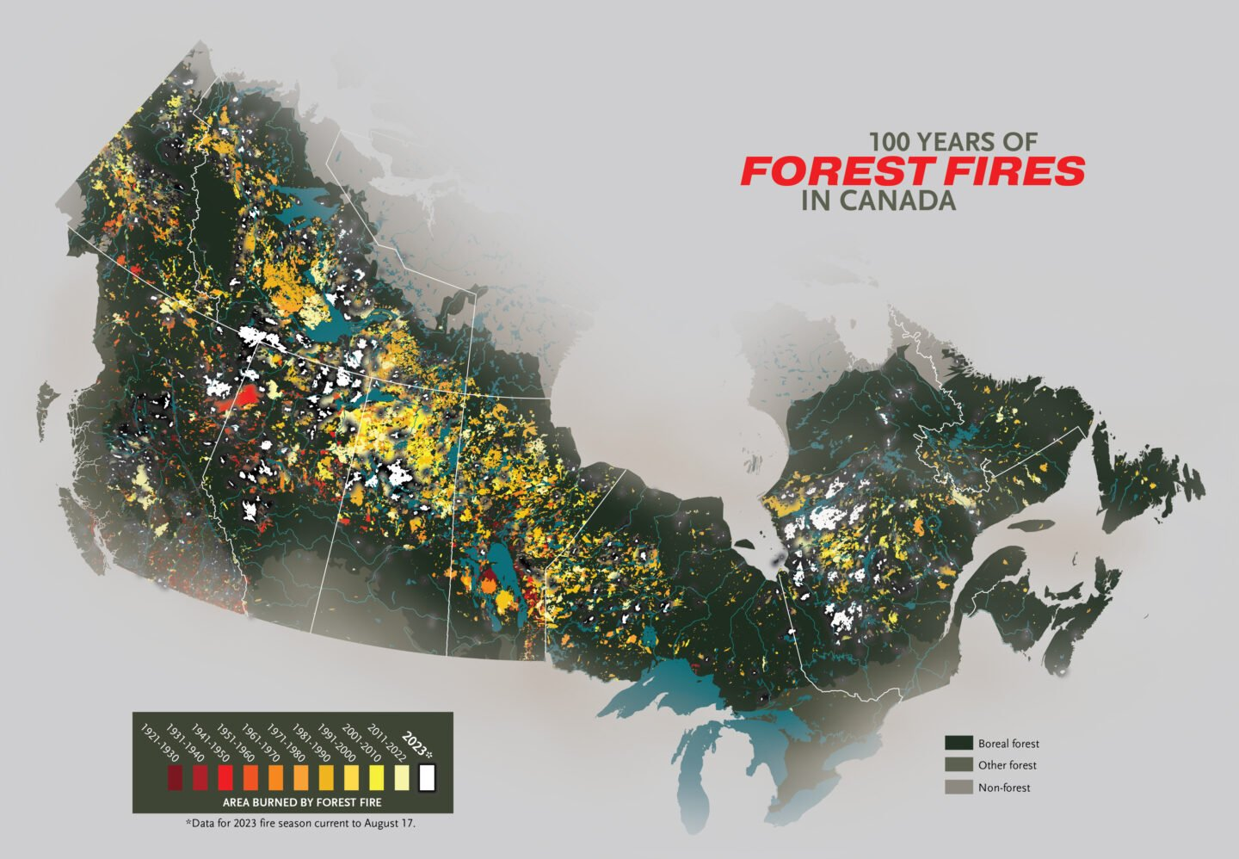
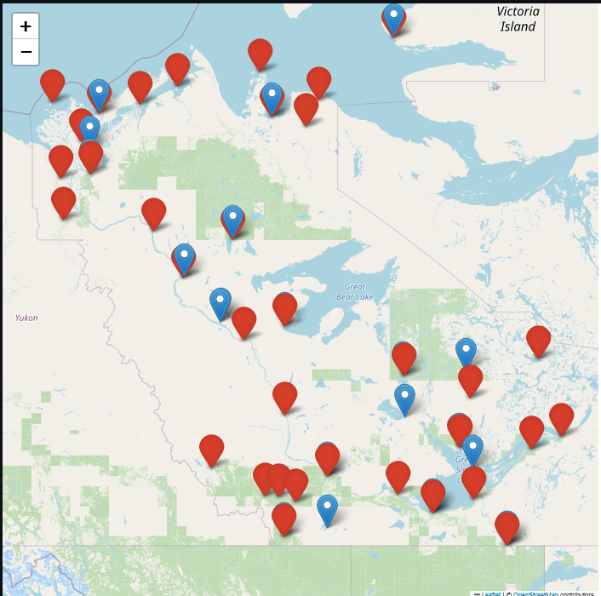
Wildfires location
Québec
Canadian Geographic cartographer Chris Brackley
https://canadiangeographic.ca/articles/mapping-100-years-of-forest-fires-in-canada/
Northwest Territories

Slide 11
Project evolution
There is to much missing data to be specific when training the model
Revised project objective:
Predict weather metrics for weather station with missing values for Canada provinces and territories
Features:
Station localization and elevation,
Year, Month, Day
Season
Prediction metrics:
Minimum, Average and Maximum temperature per day
total precipitation per day
Models:
Linear regression
https://www.canadawildfire.org/wildfirefacts

Slide 12
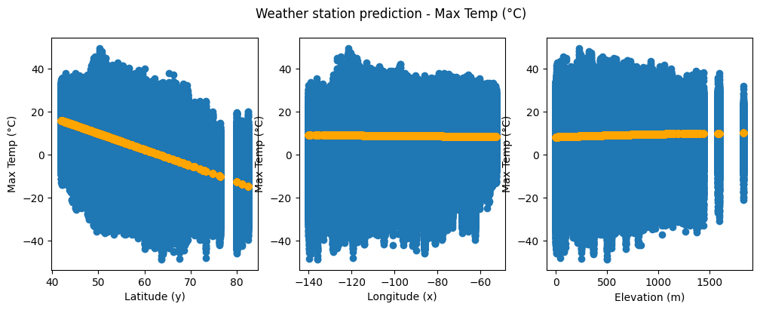
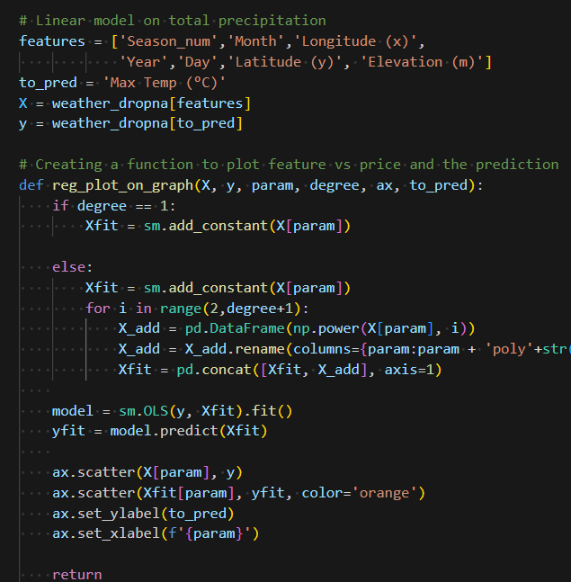
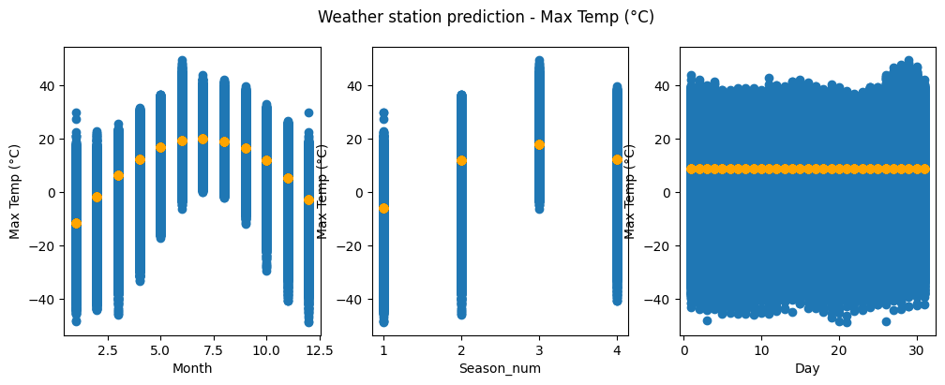
Features Visualization with Statsmodel

Slide 13
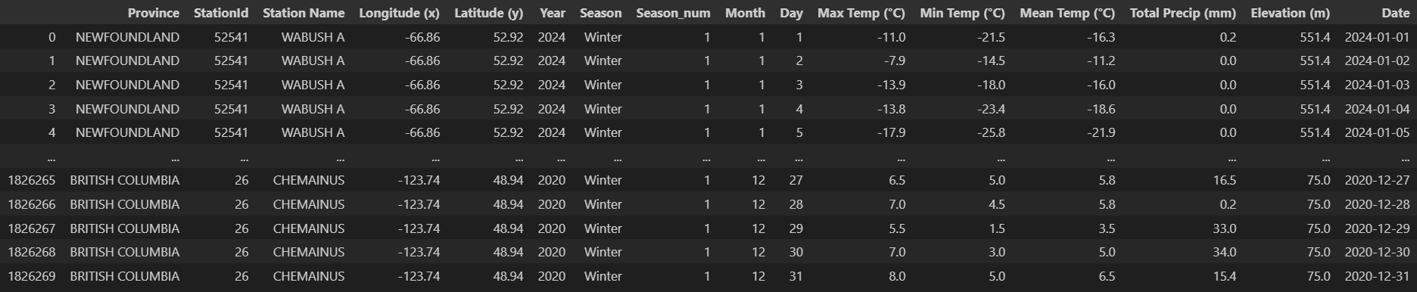
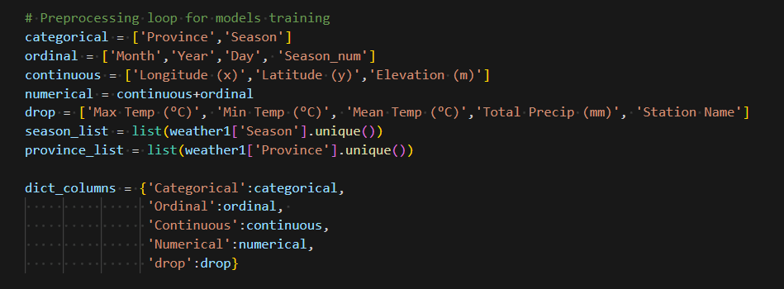
Preprocessing
Preparing to do the encoder for categorical data and scaling for numerical data

Slide 14
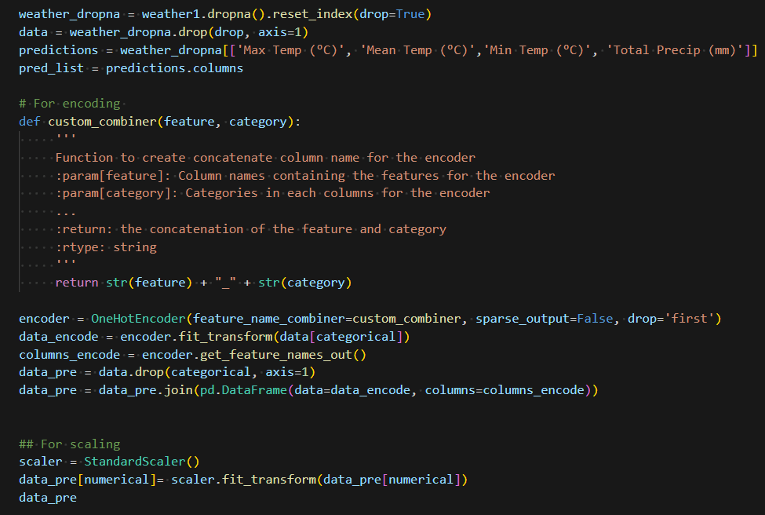
Preprocessing
Drop missing weather data
Encoding with OneHotEncoder() from scikit-learn
Scaling with StandardScaler() from scikit-learn

Slide 15
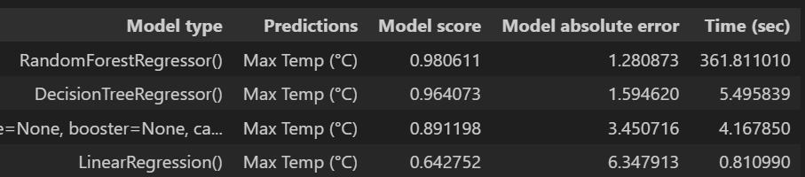
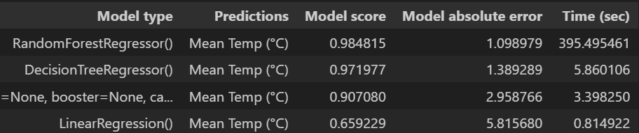
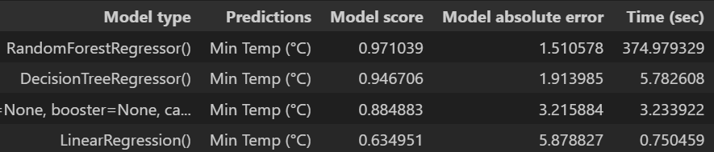
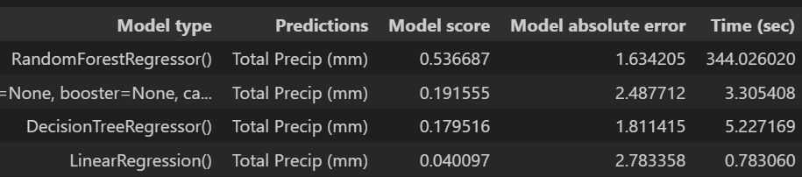
MODELs testing
From Scikit-Learn:
LinearRegression()
ElasticNet()
HubertRegression()
DecisionTreeRegressor()
RandomForestRegressor()
XGBRegressor()
From Keras:
Neural network

Slide 16
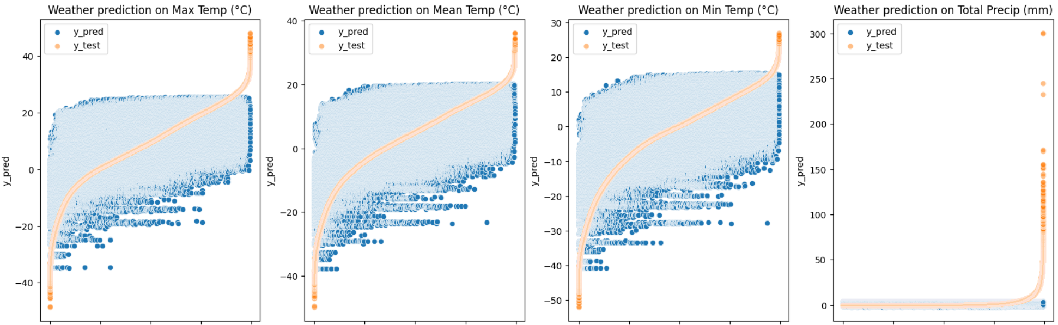
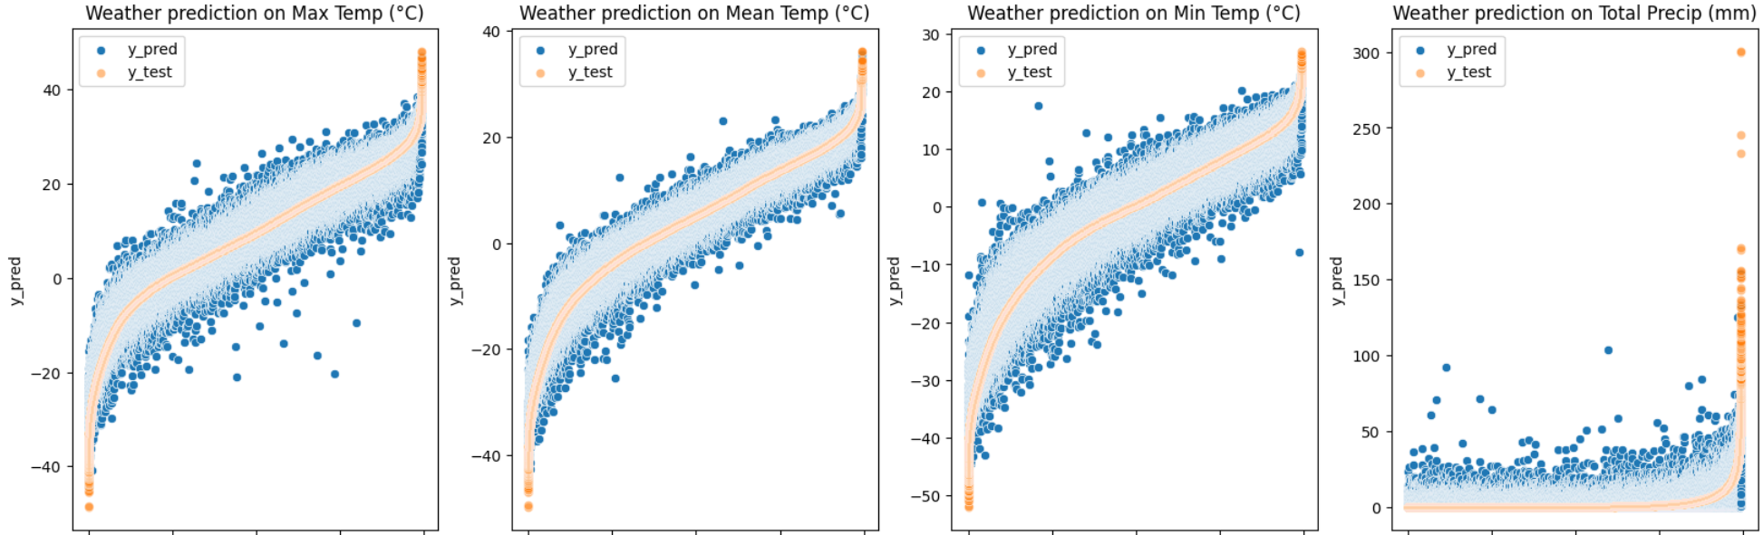
Visualization of prediction
LinearRegression()
RandomForestRegressor()

Slide 17
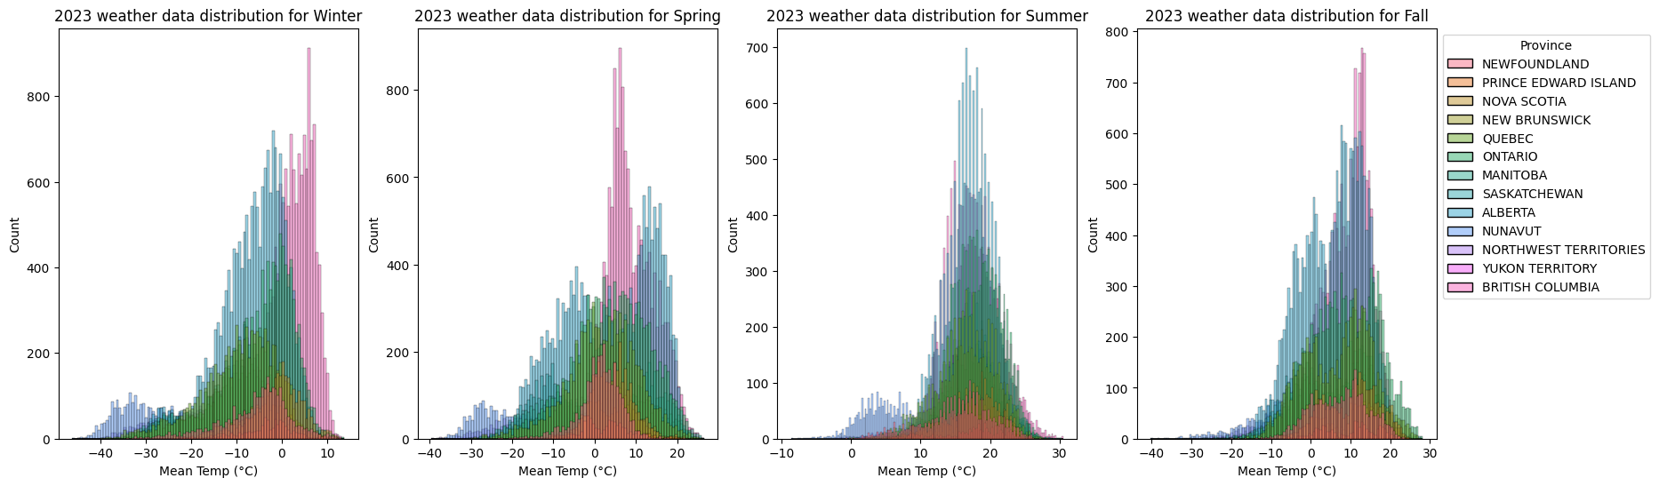
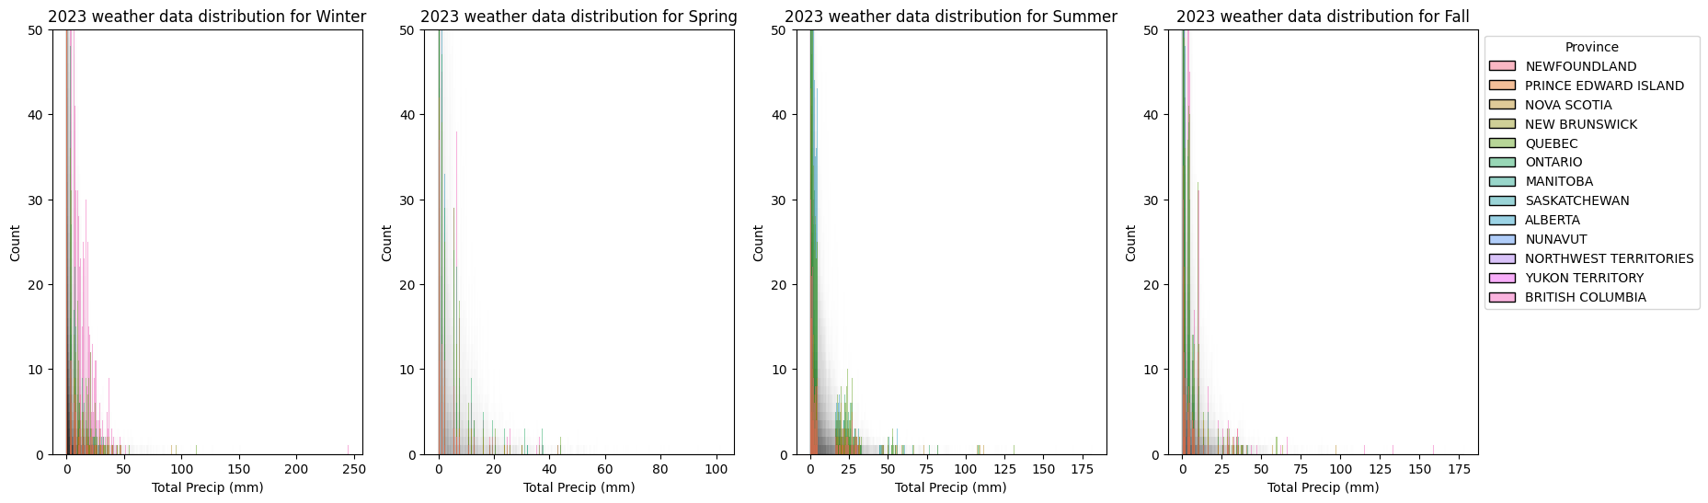
Mean temperature
Mostly normal distribution
Poisson distribution
Total precipitation

Slide 18
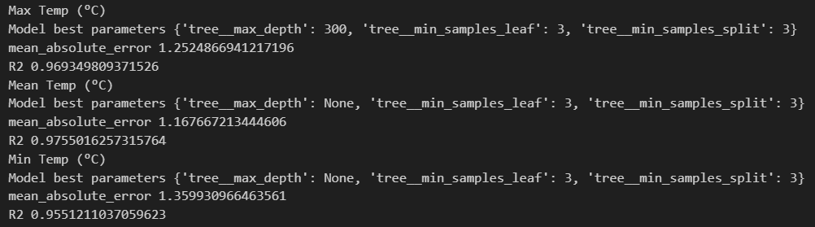
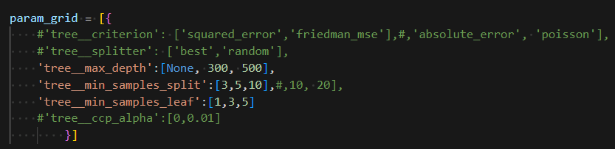
MODELs fine tuning
With GridSearch from scikit-learn

Slide 19
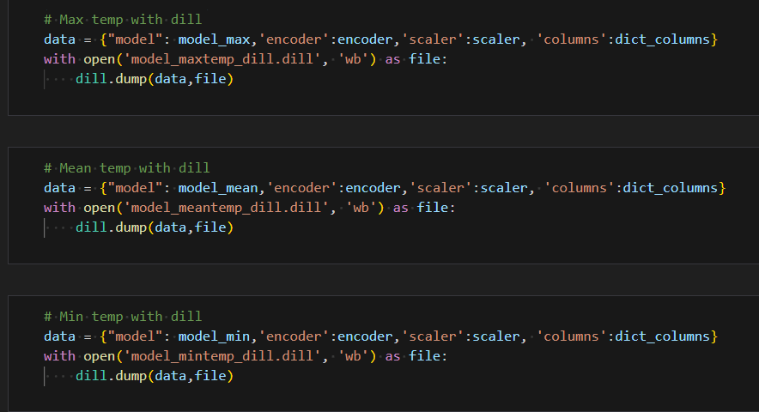
MODELs fine tuning

Slide 20
Streamlit Application Code and Demo

Slide 21
Next step
Precipitation model:
Try different models for Poisson distribution
Find more features for weather
Humidity
Atmospheric pressure
Climate location (Coast vs prairies)
Models deployment:
Research more on the root cause
Try to simplify models to reduce memory
Try to deploy with an other app

Slide 22
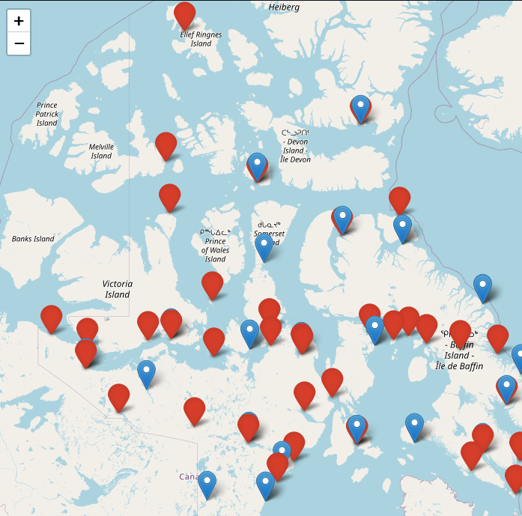
Conclusion
Model input and output initial planning
Understanding of data distribution
Exploration on model possibilities
Computer science knowledge
Github

Slide 23
Thank you
Project Repo: https://github.com/Alexlalandry/Canada_weatherstation_prediction.git
Special thanks to Anupriya and Alaa for assisting this project!
Alexandra Landry
Github: alexlalandry
Discord: alexandralandry
Email: alexandra.landry.b@gmail.com

